Slide 1
Predicting the Severity of Car Accidents in NYC
Chris Stefl

Slide 2
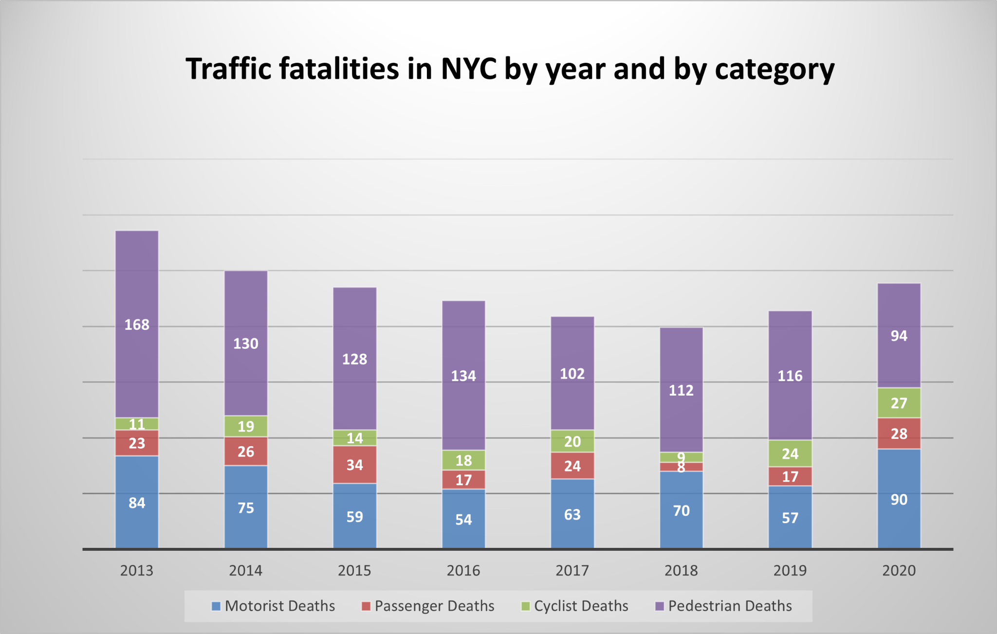
The Problem
Over 200 people die each year in NYC due to traffic related accidents

Slide 3


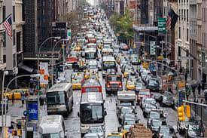
Who might care?
Local Government Car manufacturers General Public

Slide 4
Factors that affect car accidents
Location
Time
Human error
Weather
Congestion
Poorly constructed roads/sidewalks

Slide 5

Data Information
NYC Traffic Data
Period: 2012 - 2020
Location: NYC
Number of Records: 1792805
Number of Fields: 29
File Format: CSV

Slide 6
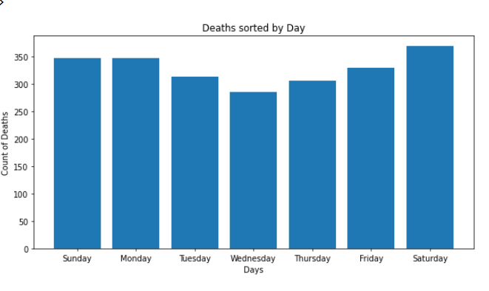
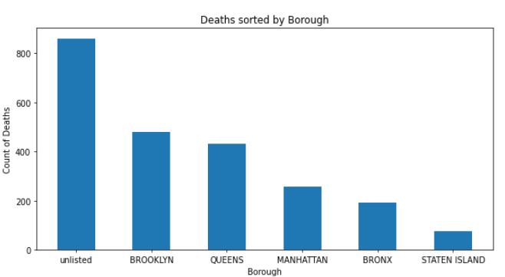
Exploratory Data Analysis

Slide 7
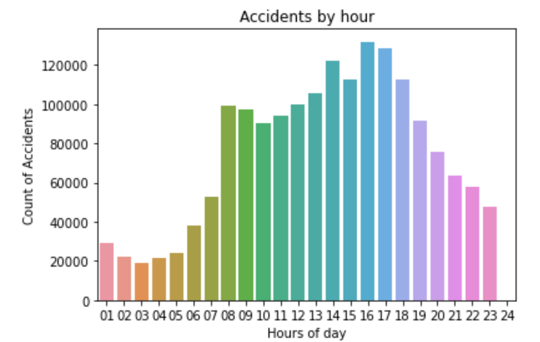
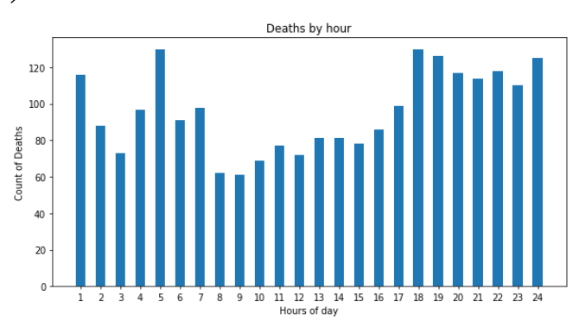
Exploratory Data Analysis

Slide 8
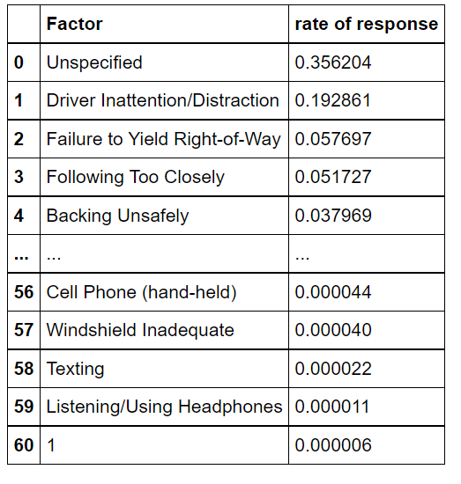
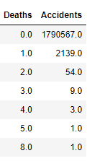
Exploratory Data Analysis
Contributing Factor
count of accidents with death rate

Slide 9
Data Engineering
Additional variables created from existing variables
Death Occurred = A boolean function that states whether or not a death occured during that accident
Beginning, middle, end of month = split month into thirds
Morning, day, evening, night = split time of day into 6 hour periods
Winter, Spring, Summer, Autumn = split year into seasons

Slide 10
Modeling overview
Type: Supervised learning
Binary classification: 1 for death and 0 for non-death
Tools: Python’s scikit learn and xgboost

Slide 11
Modeling steps
Classifier training with new optimal hyperparameters chosen from random search on the training data (70%)
Data pre-processing:
Label encoding
Split Data into test and train sets (70%-30%)
Randomly removed data to increase processing speed
Predicted test values on the hold out data (30%) with each model
Compare evaluation metrics of test and train data to make sure overfitting did not occur
Training:
Ran each model on its own with basic parameters with the training data (70%)
Used scikit-learn’s random search method
3 fold cv
Evaluation metric: Area under precision recall curve and f1-score

Slide 12
Classification Algorithms
Logistic Regression
Pros: easy to implement, fast train time, easy to interpret
Cons: prone to overfitting, does not work well with high dimensionality
Random Forest
Pros: Works well with categorical data, works well with high number of features
Cons: Has a black box effect where the model is difficult to explain
XGBoost
Pros: Handles missing values well, good with large datasets, fast train time
Cons: overfitting is very common due to high number of hyperparameters

Slide 13
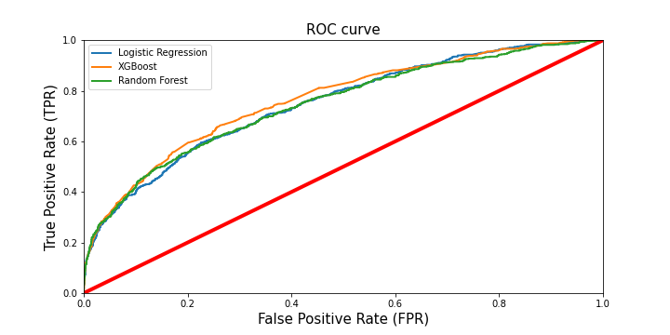
Model Comparison

Slide 14
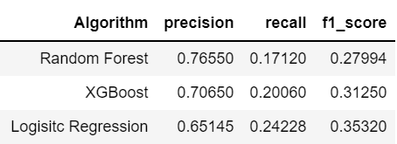

Slide 15
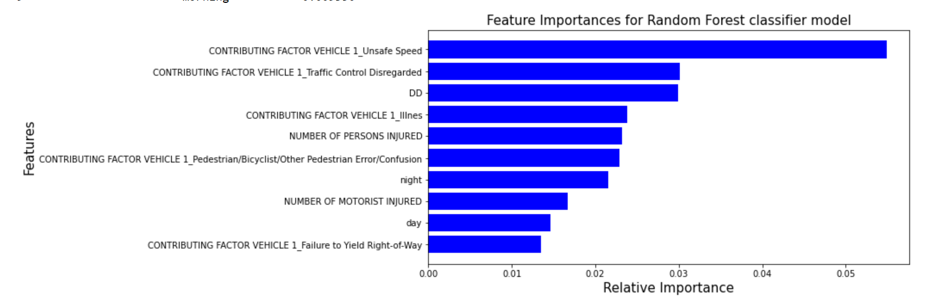
Random Forest

Slide 16
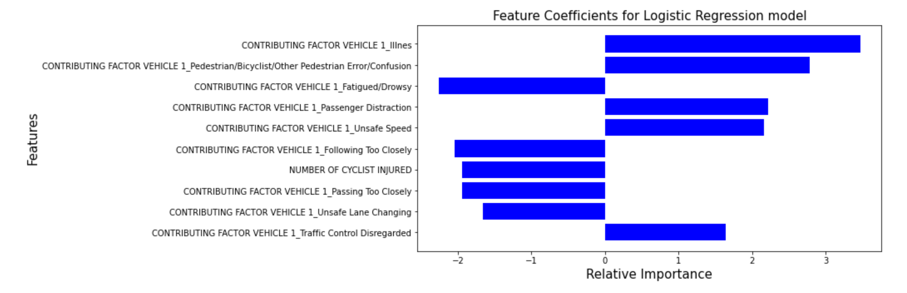
Logistic Regression

Slide 17
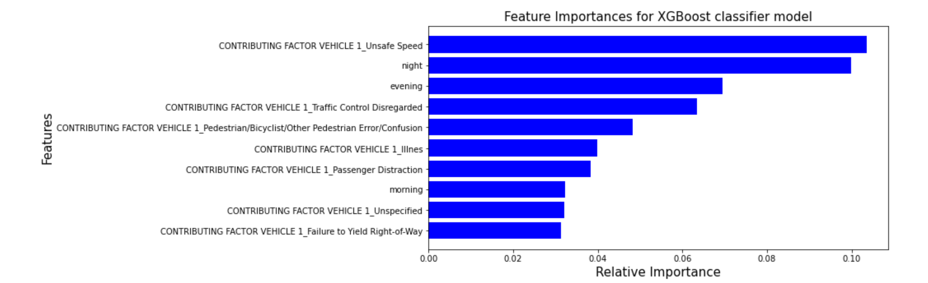
XGBoost

Slide 18
Assumptions, Limitations, and disclaimers
We assume that all accidents are independent of each other
We only used data from the past 8 years
Models did not have high accuracy and would not be great estimators for predicting car accidents
There were many missing values and some wrongly categorize values

Slide 19
More ways to improve the model
Including weather data for each day
Including a variable to count the accidents on that given day
Accurate locational data
Set cut-offs for when new laws were put into place to see the changes
Extract data from social media or comments about unsafe areas to drive in NYC and focus on those areas in particular

Slide 20
Conclusion

